Slide 1
New Service Models in the Public Library
Yesenia Baltierra
Sonia Bautista
Daisy Flores
Oleg Kagan
Natasha Martin
Erik Thurman

Slide 2
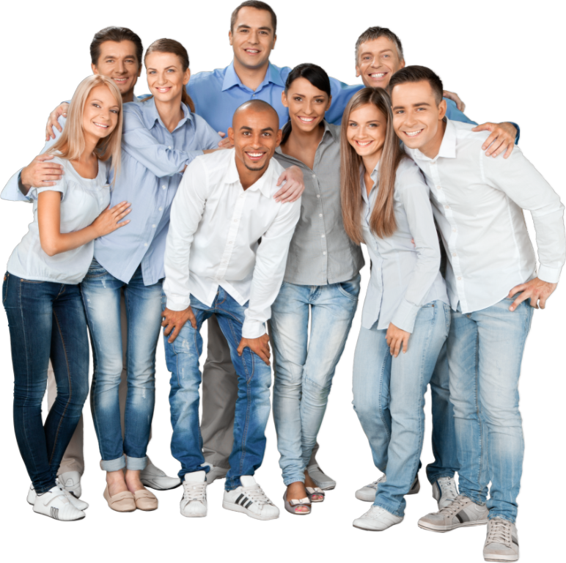
Emerging Adults
Who are they, and why?

Slide 3
LEAVING HOME
"Big Five" Markers of Adulthood
FINISHING SCHOOL
FINDING WORK
GETTING MARRIED
HAVING KIDS

Slide 4
Arnett's Framework of Emerging Adulthood
Feeling in-between -Not teenagers, but not quite adults
Being in the process of identity exploration
A focus on the self (not self-centeredness, but lacking obligation to others)
Instability
A sense of possibilities

Slide 5
Is Emerging Adulthood Universal?
YES
and
NO

Slide 6
Generation Z
ENVIRONMENTAL SCAN

Slide 7
SOCIAL
Steep Environmental Scan Model
TECHNOLOGICAL
ECONOMIC
ENVIRONMENTAL
POLITICAL

Slide 8
COMMERCIAL MARKETING
Sources Consulted
RELIGIOUS OUTREACH
MILITARY RECRUTING
POLITICAL ANALYSIS
DEMOGRAPHIC ANALYSIS

Slide 9
Diversity
MOST DIVERSE GENERATION IN AMERICAN HISTORY
MAJORITY IS NON-WHITE
GREW UP IN AN AGE OF HIGH LGBTQ+ VISIBILITY, LEGAL SAME-SEX MARRIAGE
EMERGING SELF-IDENTITY LABELS
EXPECT TO SEE DIVERSITY REFLECTED IN THEIR INSTITUTIONS

Slide 10
Social
media-savvy
PREFER VIDEO CONTENT
CONTENT SHOULD BE SHORT, FUNNY, AND INSTRUCTIVE

Slide 11
Tech savvy
GREW UP WITH SMARTPHONES
EXPECT DIGITAL PRESENCE FROM INSTITUTIONS
EXPECT INTUITIVE AND PROFESSIONAL INTERFACES

Slide 12
Entrepreneurial
MOVING AWAY FROM TRADITIONAL JOB PATHS
ENGAGING IN THE “SIDE HUSTLE,” ODD JOBS FACILITATED THROUGH APPS/WEBSITES
MONETIZATION OF HOBBIES: GAMING, MAKEUP, CRAFTS…

Slide 13
How do you find out about what is going on in your community?
What would you like to see in your community?
What are some of your current goals?
What do you want to learn or participate in, but are prevented due to barriers?
Do you use your public library? If yes, what for? If no, why?
What is your age? (optional)
What is your zip code? (optional)
Survey Questions

Slide 14
What would you like to see in your community?
EVENTS
CLEAN NEIGHBOORHOOD
LESS RACISM
LIFE SKILLS

Slide 15
What are some of your current goals?
FINISH COLLEGE/UNIVERSITY
HEALTH
MOVE OUT OF PARENT'S HOME
FIND A JOB

Slide 16
What do you want to learn or participate in, but are prevented due to barriers?
LEARN LIFE SKILLS - COOKING, INVESTING
VOLUNTEER
HEALTH
HOMELESSNESS

Slide 17
Reasons for visiting a library
TO STUDY
A QUIET ENVIRONMENT
CHECK OUT BOOKS

Slide 18
Reasons for not visiting a library
NO TIME
AVAILABILITY OF HOURS
NOT INTERESTED

Slide 19
Service Model Recommendations
1. Emerging Adults Marketing Delivery Toolkit
2. Connecting People to People (Social Capital)

Slide 20
1. Emerging Adults Marketing Delivery Toolkit
Toolkit adaptable to each community, defining best practices
Social Media-ready videos
App creation for statewide, one-stop source for EA services

Slide 21
2. Connecting People to People (Social Capital)
Building EA services outside the library, in the EA community
Digital service/presence
Library as a community space
Mentor matchmaking
Connect people to build social capital

Slide 22
Thank you!
Developing Leaders in California Libraries is a program of the California Library Association, supported in whole or in part by the U.S. Institute of Museum and Library Services under the provisions of the Library Services and Technology Act, administered in California by the State Librarian.

